Slide 1

Data structures using C
Module 5 - Lecture III
Searching & Sorting
Prepared By
Ms. Smriti Sehgal

Slide 2
Syllabus
Insertion Sort, Bubble sort, Selection sort, Quick sort, Merge sort, Heap sort, Partition exchange sort, Shell sort, Sorting on different keys, External sorting. Linear search, Binary search, Hashing: Hash Functions, Collision Resolution Techniques.

Slide 3
In this session
We will talk about
Partition exchange sort
Shell sort
Sorting on different keys
External sorting.

Slide 4
Partition Exchange Sort
Quicksort (sometimes called partition-exchange sort) is an efficient sorting algorithm, serving as a systematic method for placing the elements of a random access file or an array in order.

Slide 5
Shell Sort
Shell sort is a highly efficient sorting algorithm and is based on insertion sort algorithm.
This algorithm avoids large shifts as in case of insertion sort, if the smaller value is to the far right and has to be moved to the far left.
This algorithm uses insertion sort on a widely spread elements, first to sort them and then sorts the less widely spaced elements. This spacing is termed as interval. This interval is calculated based on Knuth's formula as −
Knuth's Formula
h = h * 3 + 1 where − h is interval with initial value

Slide 6
Shell Sort
This algorithm is quite efficient for medium-sized data sets as its average and worst-case complexity of this algorithm depends on the gap sequence the best known is Ο(n), where n is the number of items.
And the worst case space complexity is O(n).

Slide 7
How shell sort works?
Let us consider the following example to have an idea of how shell sort works.
For our example and ease of understanding, we take the interval of 4.
Make a virtual sub-list of all values located at the interval of 4 positions. Here these values are {35, 14}, {33, 19}, {42, 27} and {10, 44}

Slide 8
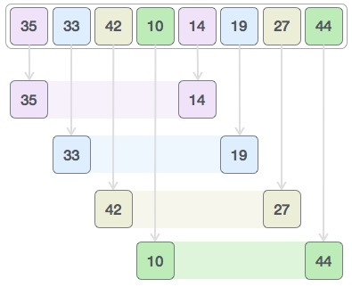

How shell sort works?
We compare values in each sub-list and swap them (if necessary) in the original array. After this step, the new array should look like this –

Slide 9
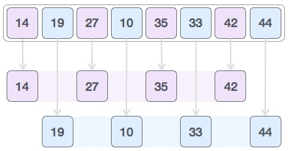

How shell sort works?
Then, we take interval of 1 and this gap generates two sub-lists - {14, 27, 35, 42}, {19, 10, 33, 44}
We compare and swap the values, if required, in the original array. After this step, the array should look like this −

Slide 10
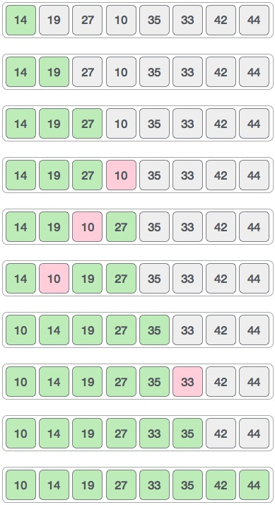
How shell sort works?
Finally, we sort the rest of the array using interval of value 1. Shell sort uses insertion sort to sort the array.
Following is the step-by-step depiction
We see that it required only four swaps to sort the rest of the array.

Slide 11
Shell sort algorithm
Algorithm
Following is the algorithm for shell sort.
Step 1 − Initialize the value of h
Step 2 − Divide the list into smaller sub-list of equal interval h
Step 3 − Sort these sub-lists using insertion sort
Step 4 − Repeat until complete list is sorted

Slide 12
Shell sort
Key points of shell sort algorithm
Shell Sort is a comparison based sorting.
Time complexity of Shell Sort depends on gap sequence. Its best case time complexity is O(n* logn) and worst case is O(n* log²n). Time complexity of Shell sort is generally assumed to be near to O(n) and less than O(n²) as determining its time complexity is still an open problem.
The best case in shell sort is when the array is already sorted. The number of comparisons is less.
It is an in-place sorting algorithm as it requires no additional scratch space.
Shell Sort is unstable sort as relative order of elements with equal values may change.
It is been observed that shell sort is 5 times faster than bubble sort and twice faster than insertion sort its closest competitor.
There are various increment sequences or gap sequences in shell sort which produce various complexity between O(n) and O(n²).

Slide 13
Sort on different keys
Sorting refers to the operation or technique of arranging and rearranging sets of data in some specific order. A collection of records called a list where every record has one or more fields. The fields which contain a unique value for each record is termed as the key field.
For example, a phone number directory can be thought of as a list where each record has three fields - 'name' of the person, 'address' of that person, and their 'phone numbers'. Being unique phone number can work as a key to locate any record in the list. Sorting is the operation performed to arrange the records of a table or list in some order according to some specific ordering criterion. Sorting is performed according to some key value of each record. The records are either sorted either numerically or alphanumerically. The records are then arranged in ascending or descending order depending on the numerical value of the key. Here is an example, where the sorting of a lists of marks obtained by a student in any particular subject of a class.

Slide 14
Why Sort?
A classic problem in computer science!
Data requested in sorted order
e.g., find students in increasing gpa order
Sorting is first step in bulk loading B+ tree index.
Sorting useful for eliminating duplicate copies in a collection of records (Why?)
Sort-merge join algorithm involves sorting.
Problem: sort 1Gb of data with 1Mb of RAM.
why not virtual memory?
Notes:
4

Slide 15
2-Way Sort: Requires 3 Buffers
Pass 1: Read a page, sort it, write it.
only one buffer page is used
Pass 2, 3, …, etc.:
three buffer pages used.
INPUT 1
OUTPUT
INPUT 2
Main memory buffers
Disk
Disk
Notes:
5

Slide 16
Two-Way External Merge Sort
Each pass we read + write each page in file.
N pages in the file => the number of passes
So toal cost is:
Idea: Divide and conquer: sort subfiles and merge
3,4
6,2
9,4
8,7
5,6
3,1
2
Input file
PASS 0
3,4
2,6
4,9
7,8
5,6
1,3
2
1-page runs
PASS 1
2,3
4,7
1,3
2-page runs
4,6
8,9
5,6
2
PASS 2
2,3
4,4
1,2
4-page runs
6,7
3,5
8,9
6
PASS 3
1,2
2,3
3,4
8-page runs
4,5
6,6
7,8
9
Notes:
6

Slide 17
General External Merge Sort
More than 3 buffer pages. How can we utilize them?
To sort a file with N pages using B buffer pages:
Pass 0: use B buffer pages. Produce sorted runs of B pages each.
Pass 2, …, etc.: merge B-1 runs.
INPUT 1
. . .
INPUT 2
. . .
. . .
OUTPUT
INPUT B-1
Disk
Disk
B Main memory buffers
Notes:
7

Slide 18
Cost of External Merge Sort
Number of passes:
Cost = 2N * (# of passes)
E.g., with 5 buffer pages, to sort 108 page file:
Pass 0: = 22 sorted runs of 5 pages each (last run is only 3 pages)
Pass 1: = 6 sorted runs of 20 pages each (last run is only 8 pages)
Pass 2: 2 sorted runs, 80 pages and 28 pages
Pass 3: Sorted file of 108 pages
Notes:
8

Slide 19
Number of Passes of External Sort
Notes:
9

Slide 20
I/O for External Merge Sort
… longer runs often means fewer passes!
Actually, do I/O a page at a time
In fact, read a block of pages sequentially!
Suggests we should make each buffer (input/output) be a block of pages.
But this will reduce fan-out during merge passes!
In practice, most files still sorted in 2-3 passes.

Slide 21
Number of Passes of Optimized Sort
Block size = 32, initial pass produces runs of size 2B.
Notes:
13

Slide 22
Double Buffering
To reduce wait time for I/O request to complete, can prefetch into `shadow block’.
Potentially, more passes; in practice, most files still sorted in 2-3 passes.
INPUT 1
INPUT 1'
INPUT 2
OUTPUT
INPUT 2'
OUTPUT'
b
Disk
INPUT k
block size
Disk
INPUT k'
B main memory buffers, k-way merge

Slide 23
Sorting Records!
Sorting has become a blood sport!
Parallel sorting is the name of the game ...
Datamation: Sort 1M records of size 100 bytes
Typical DBMS: 15 minutes
World record: 3.5 seconds
12-CPU SGI machine, 96 disks, 2GB of RAM
New benchmarks proposed:
Minute Sort: How many can you sort in 1 minute?
Dollar Sort: How many can you sort for $1.00?

Slide 24


